Slide 1
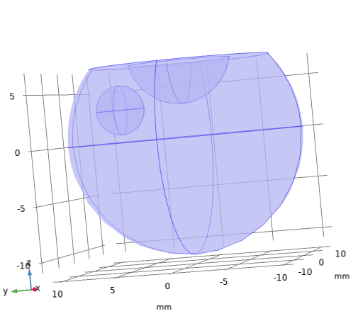
Figure 1
Inflow
u = 0 - 0.00015 mm/s
Drug injected
location
Hyaloid
membrane
C = 0
(all cases)
Anterior
vitreous
outer
surface
C_{i} = 0.167 mol/m³
Lens
No
flux
No flux
Posterior
vitreous
outer
surface
C = 0
(b cases)
Vitreous
Fovea
Outflow
P = 0
a)
b)

Slide 2
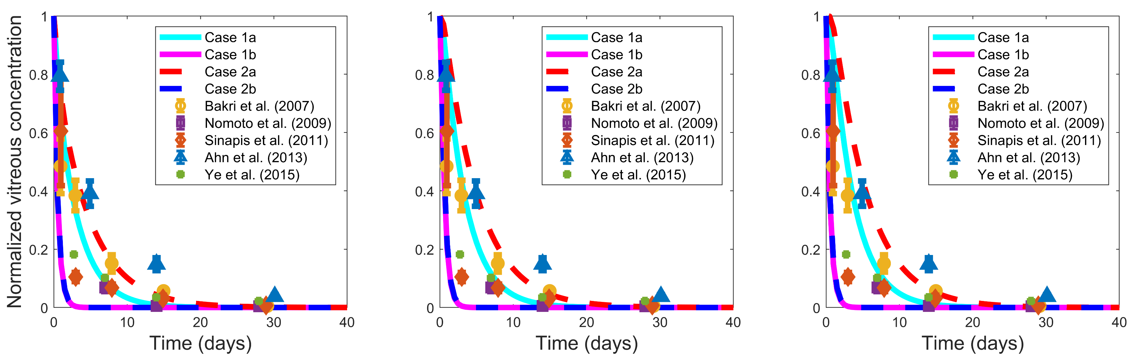
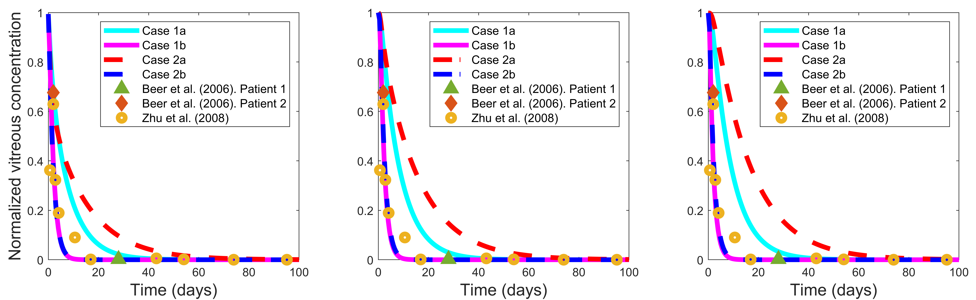
Figure 3
a)
b)
c)
d)
e)
f)

Slide 3
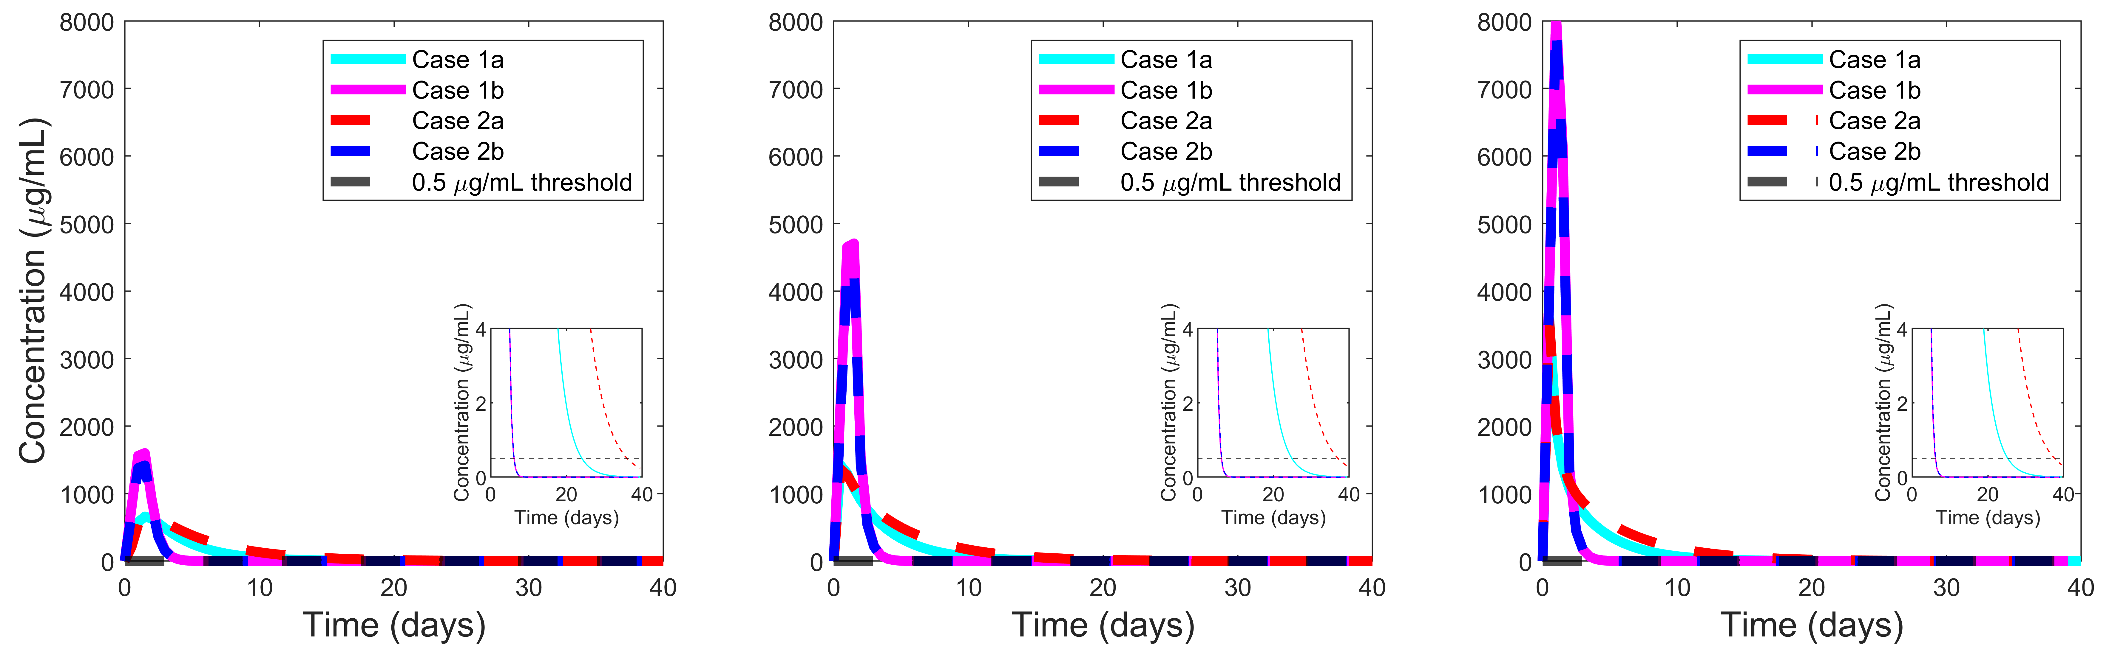
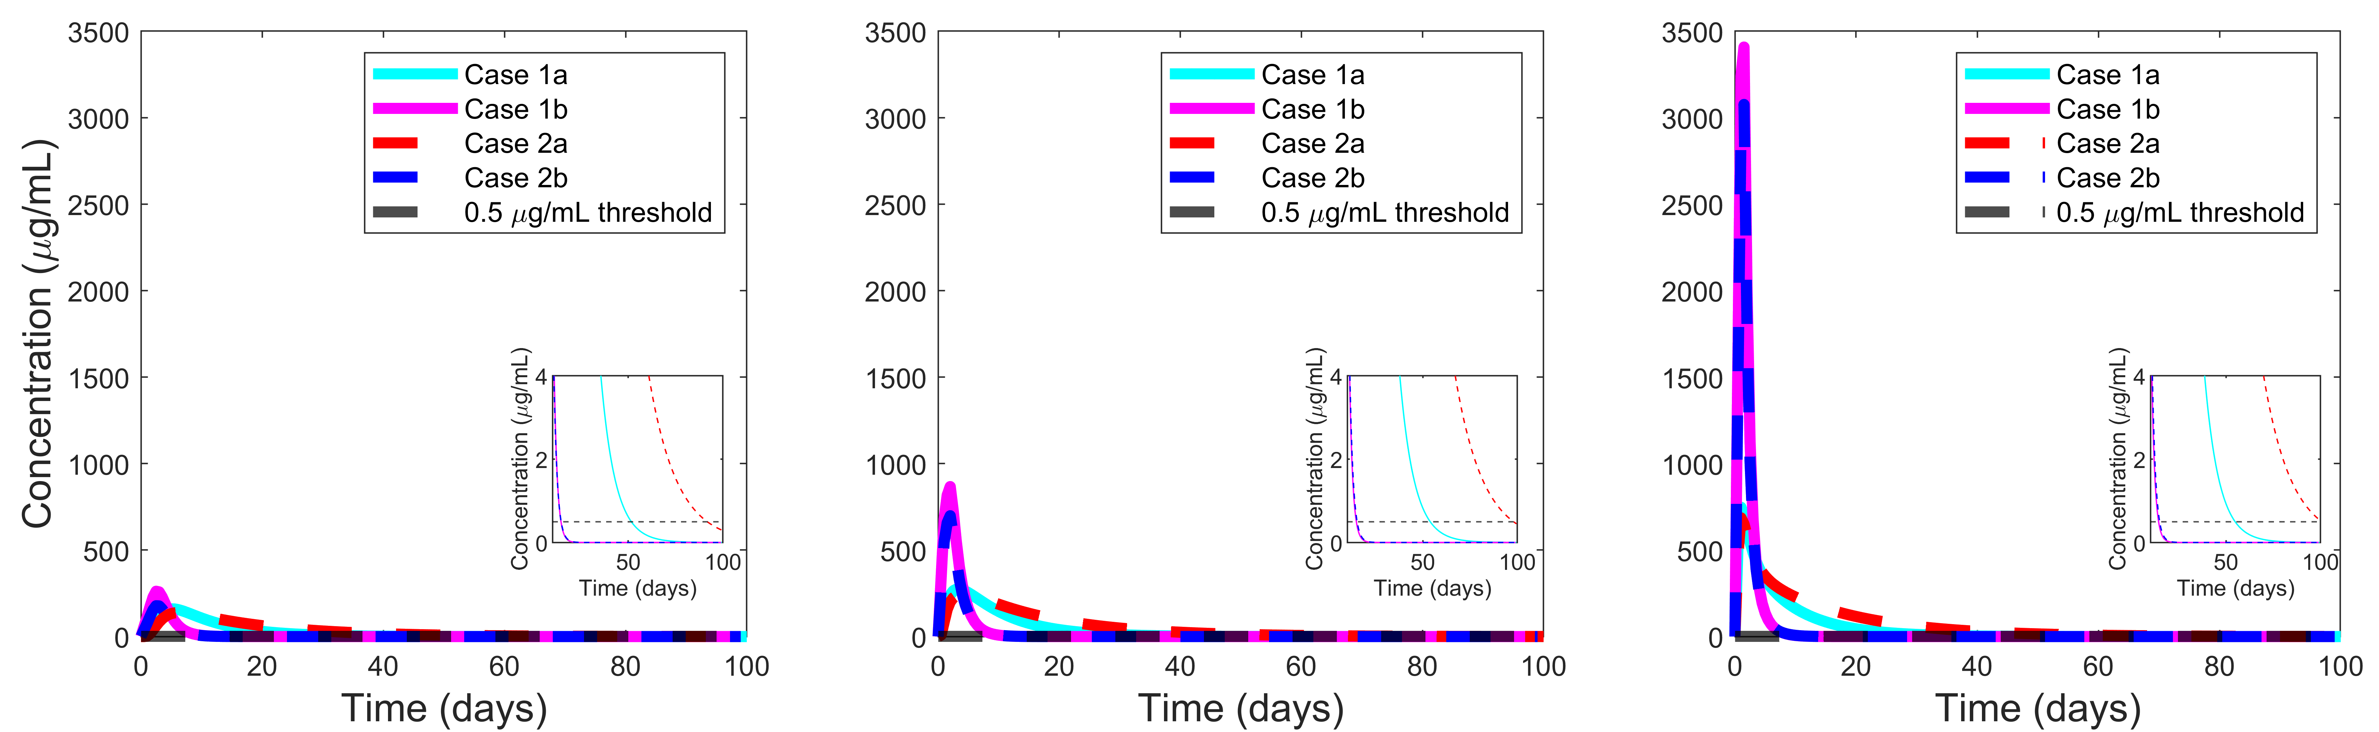
Figure 4
a)
b)
c)
d)
e)
f)

Slide 4
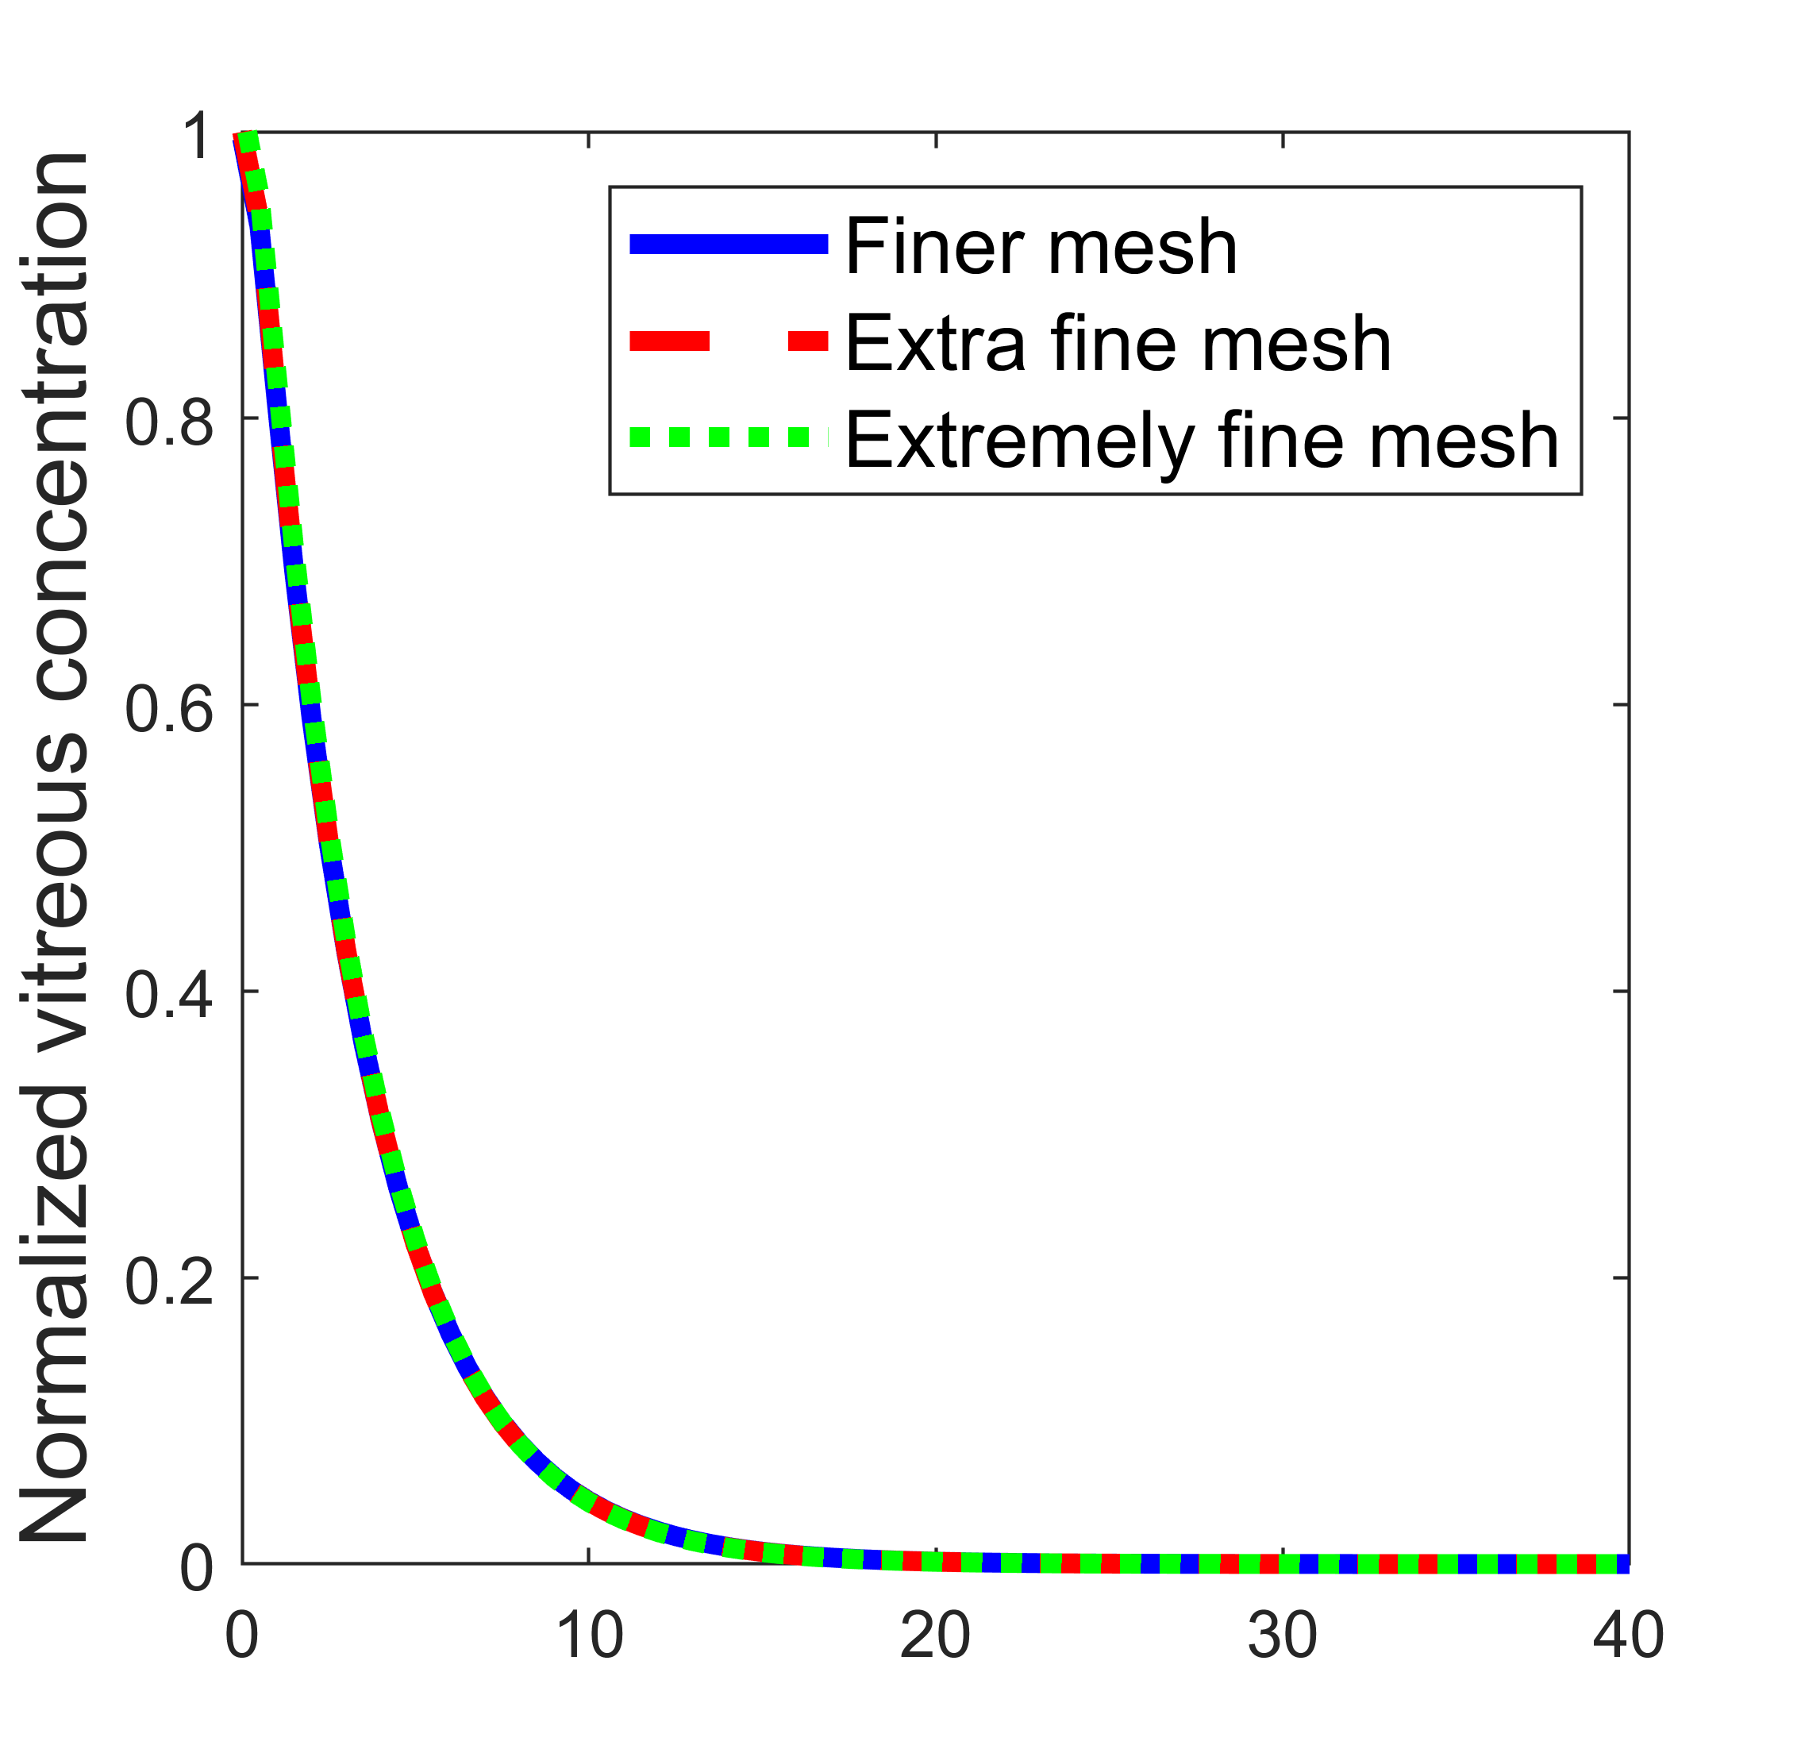
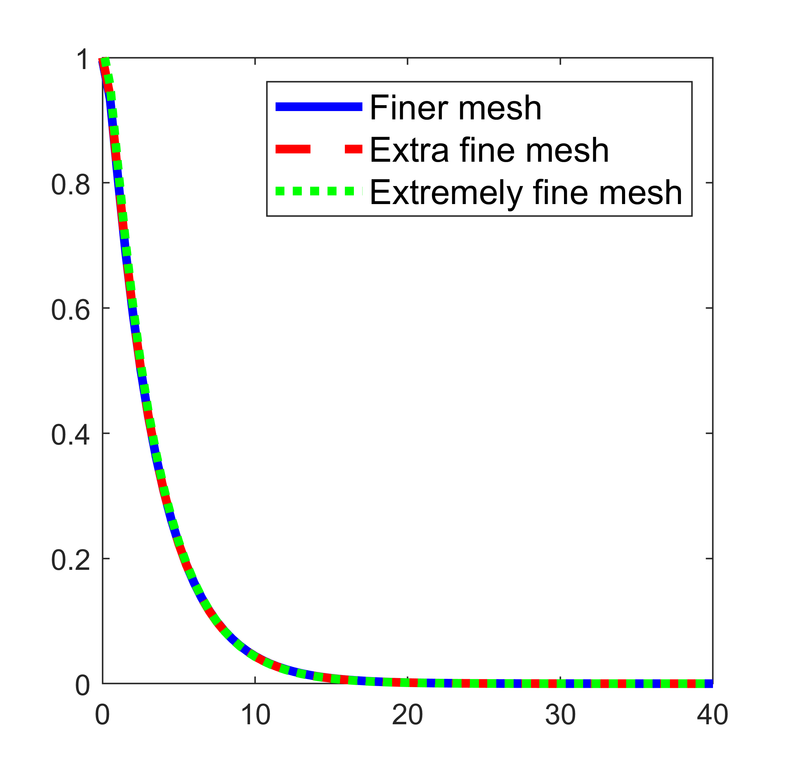
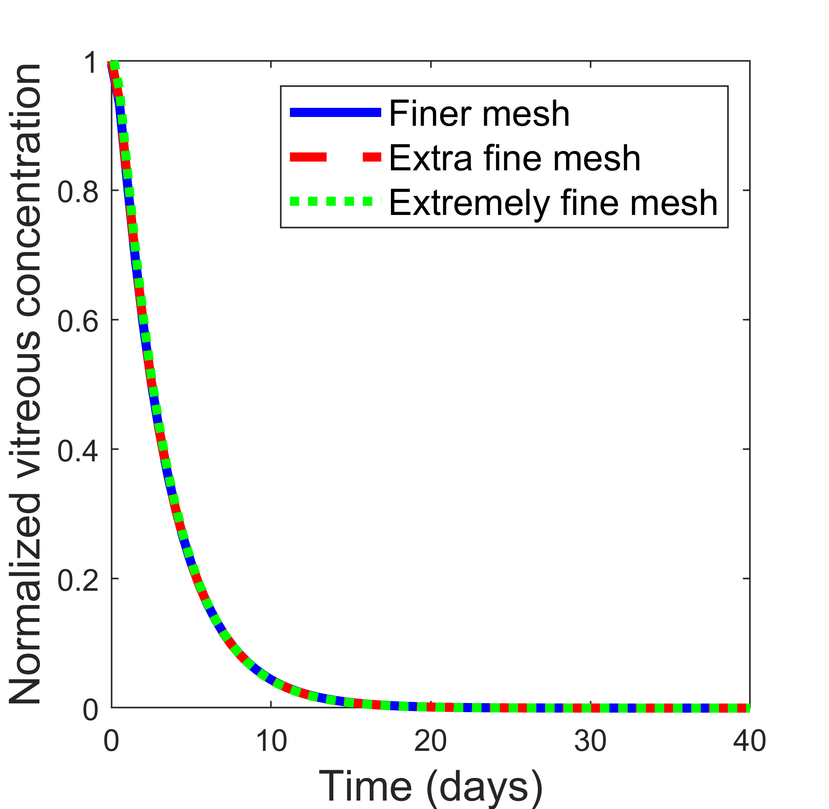
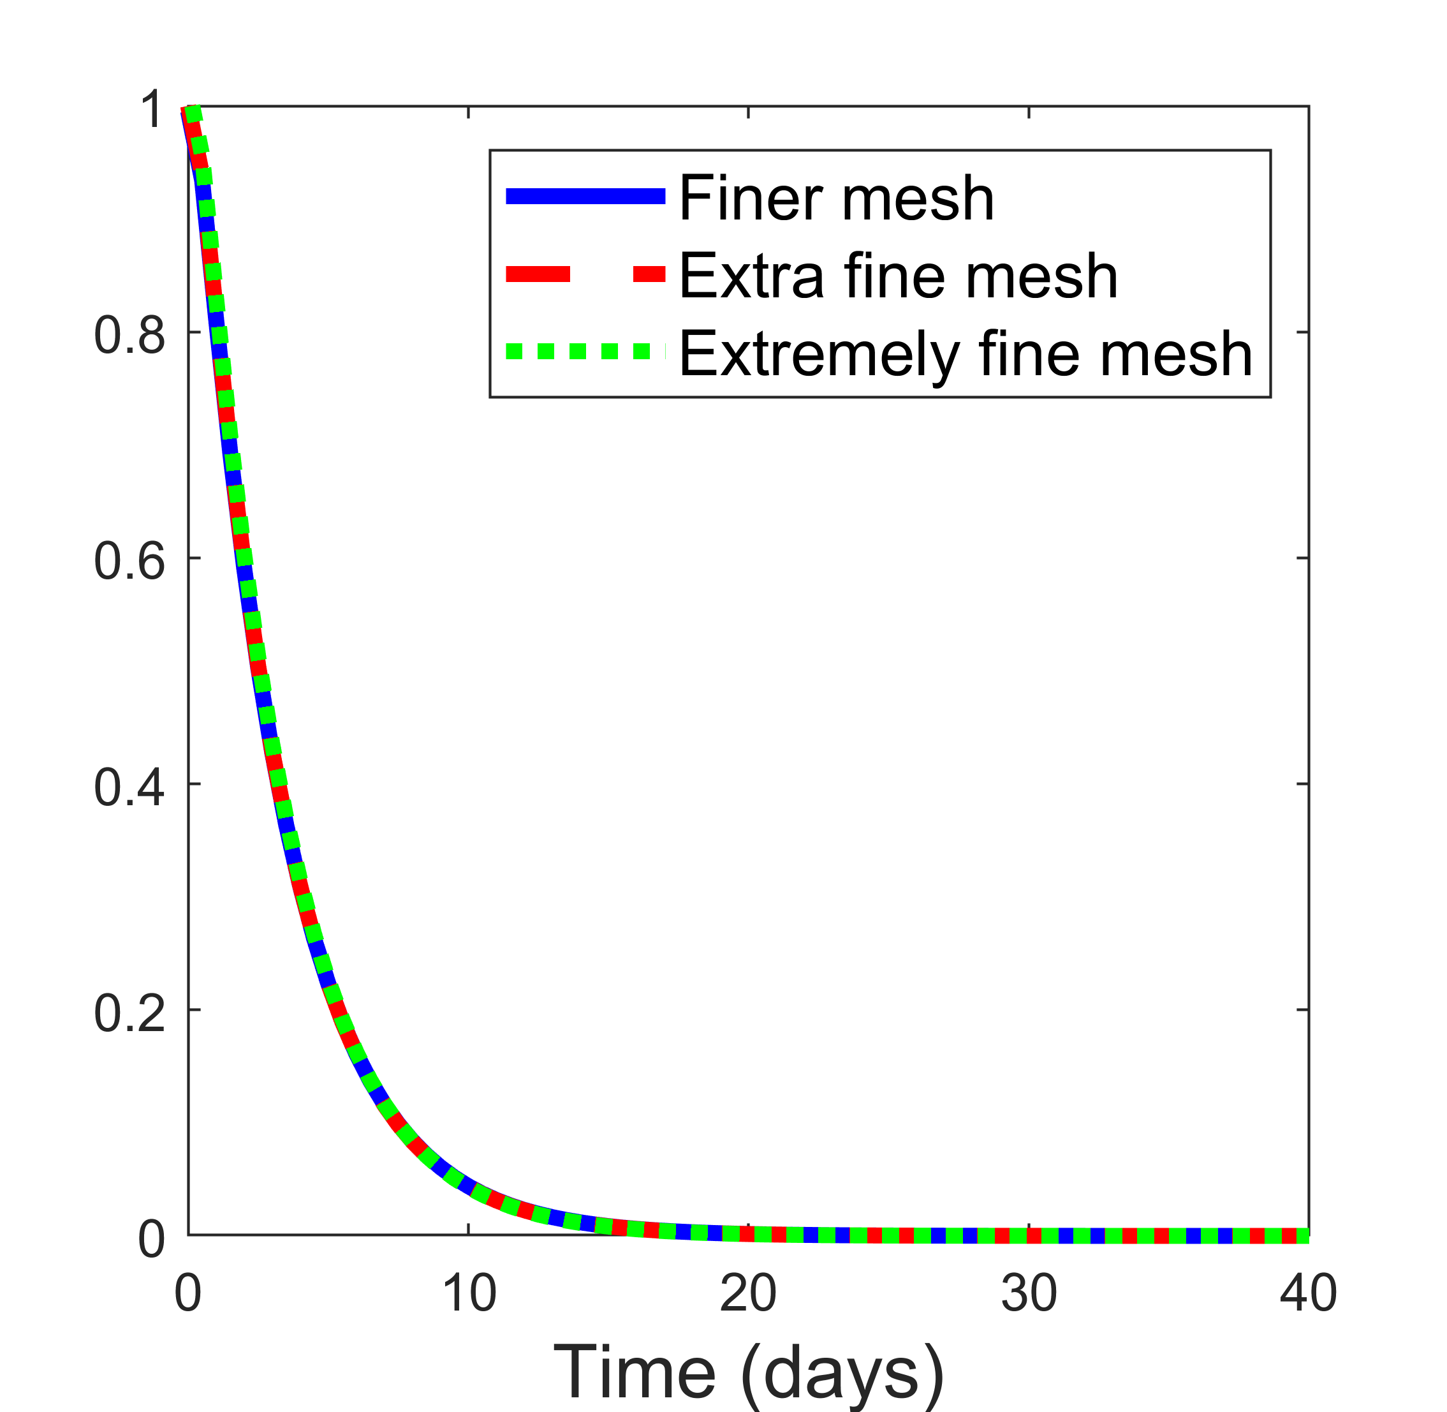
Figure S1
a)
b)
c)
d)

Slide 5
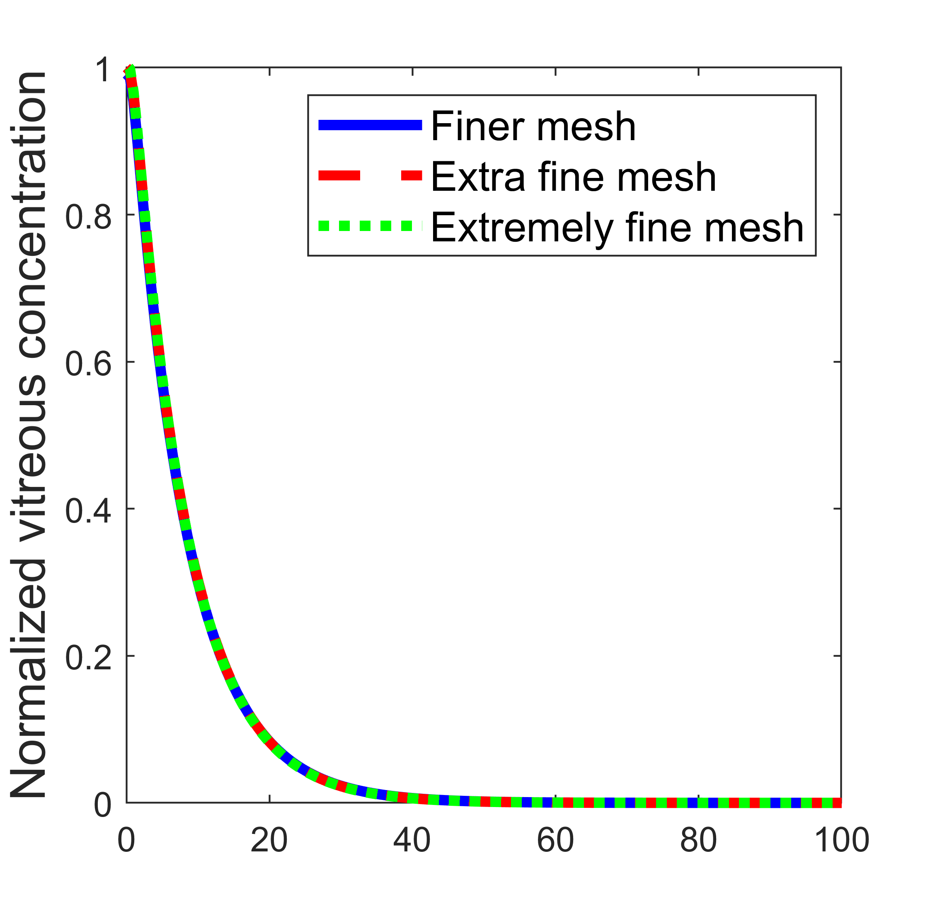
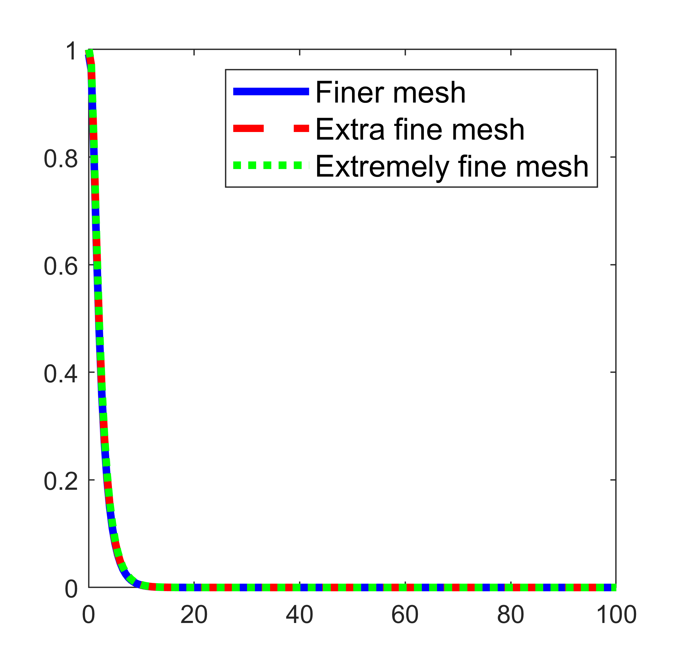
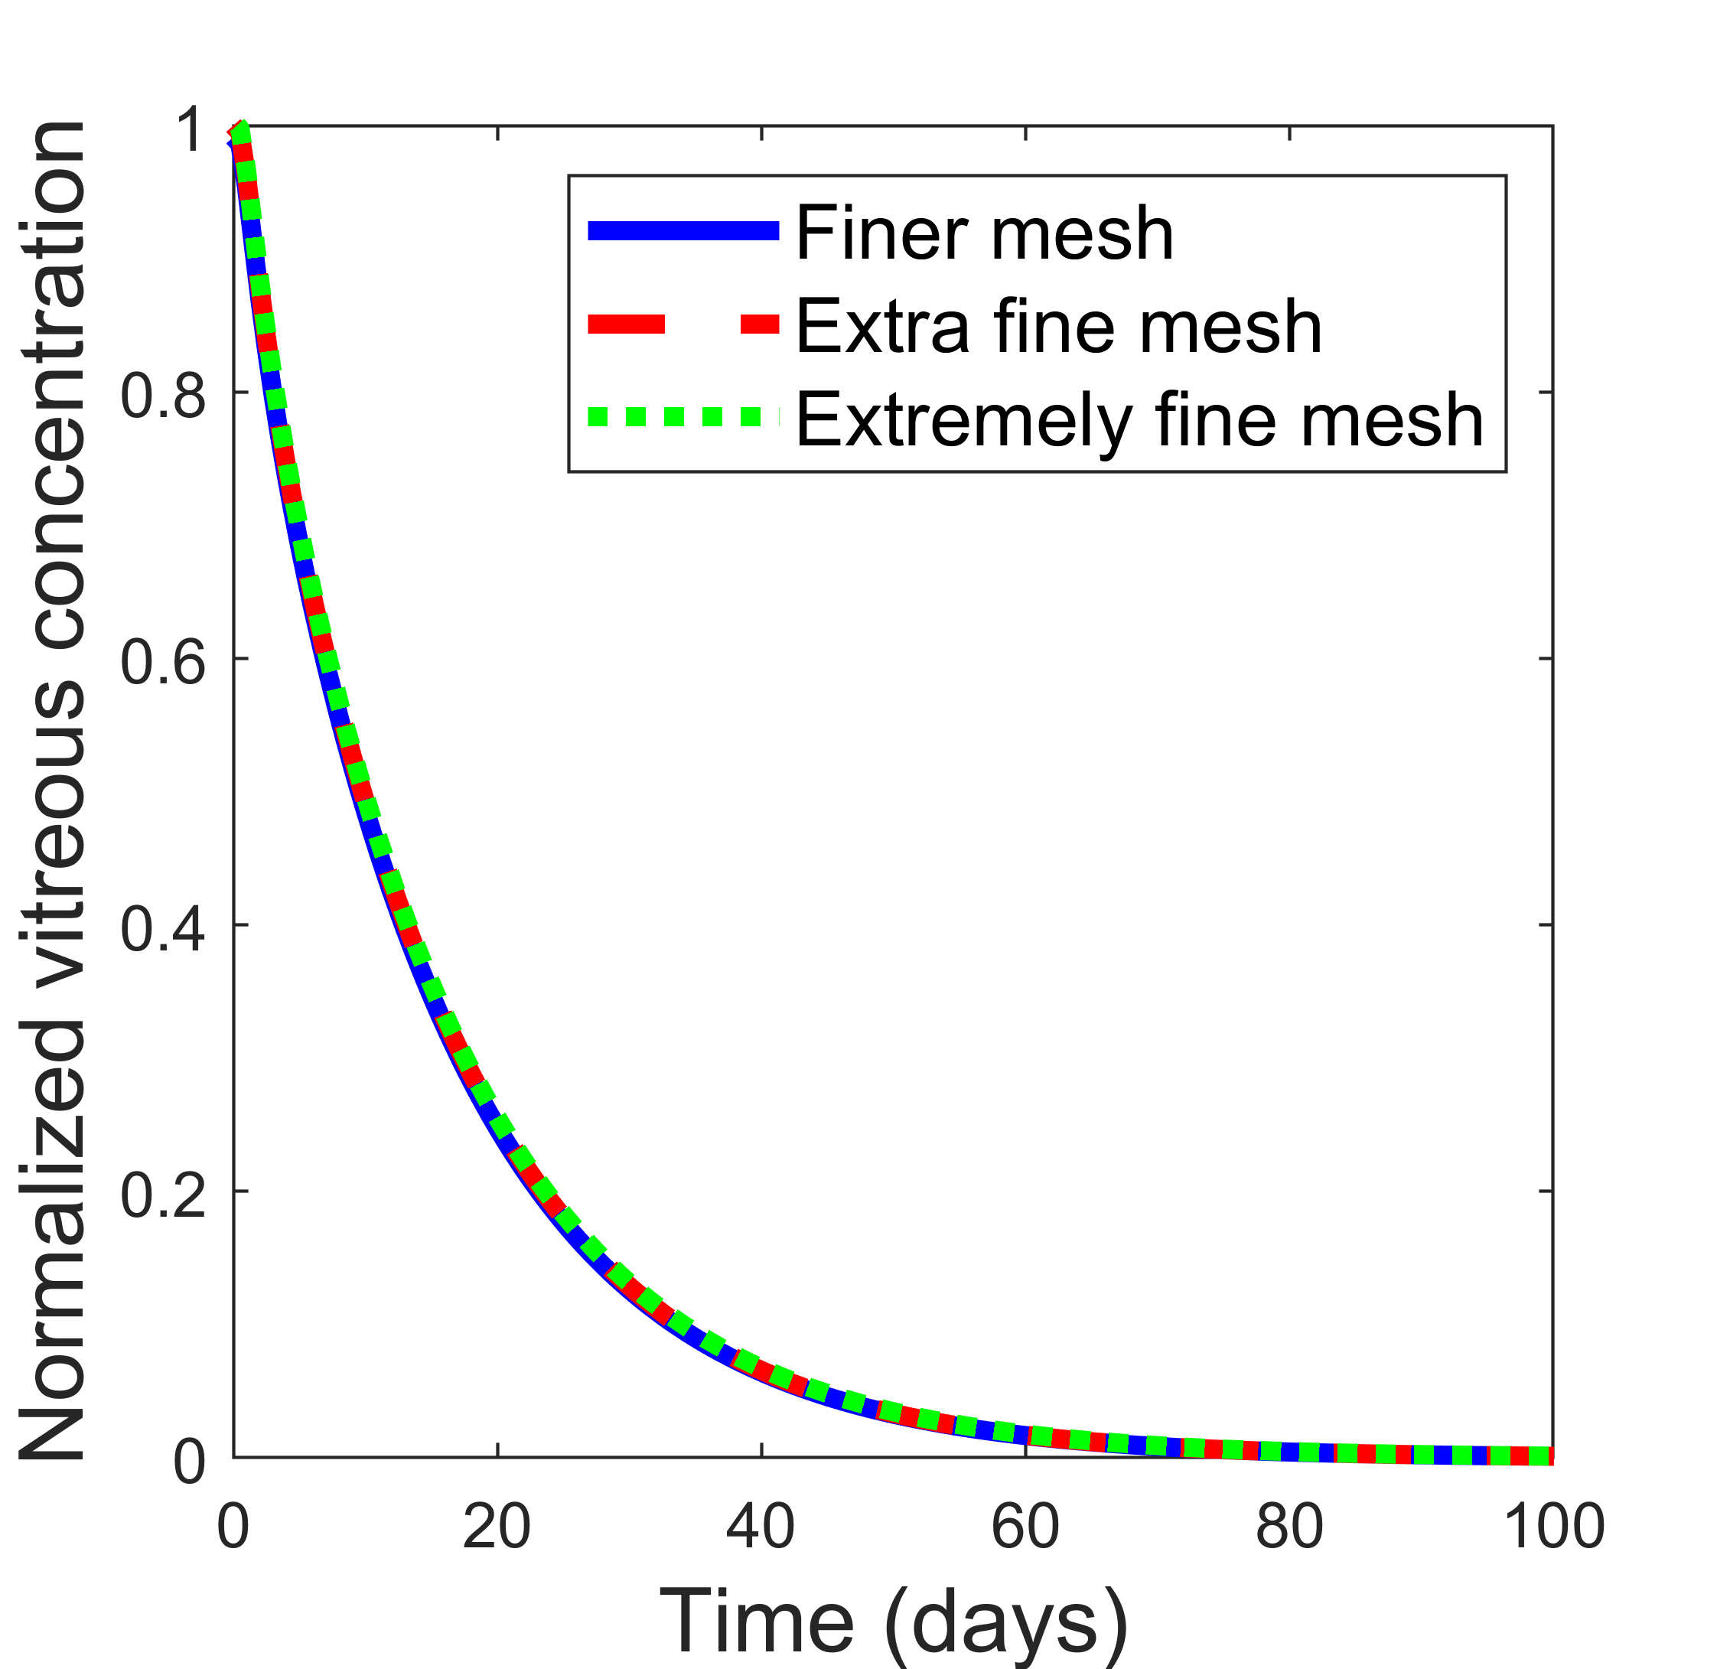
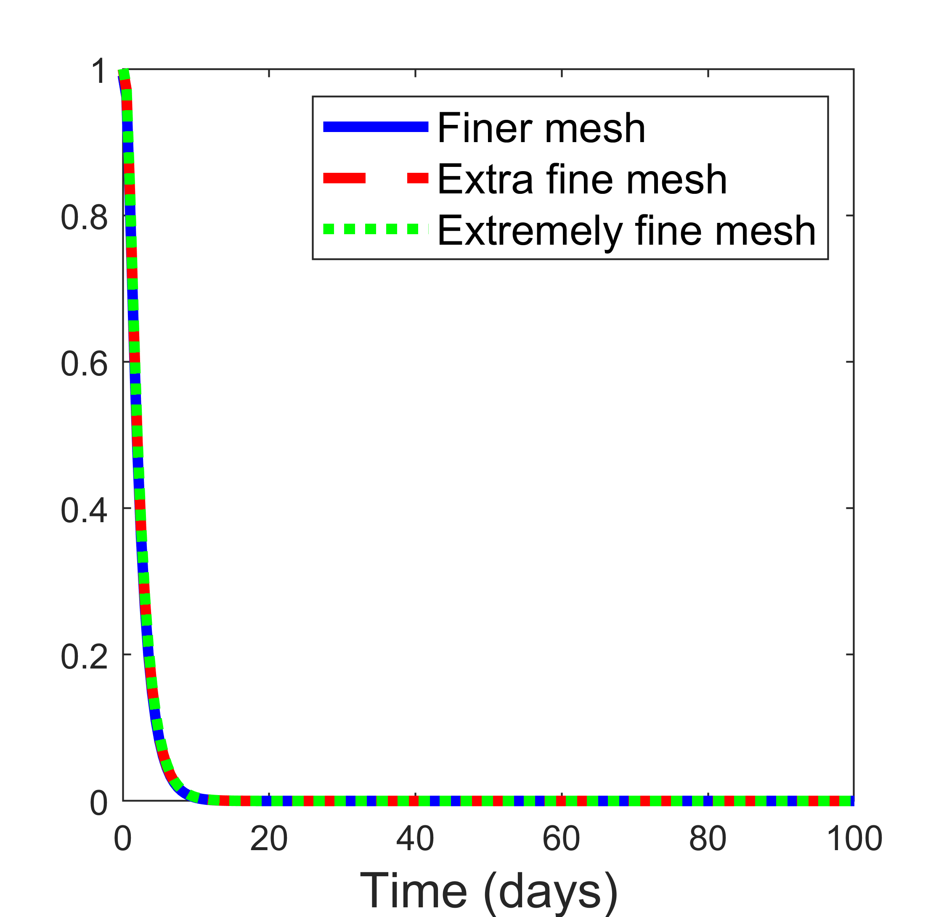
Figure S2
a)
b)
c)
d)

Slide 6
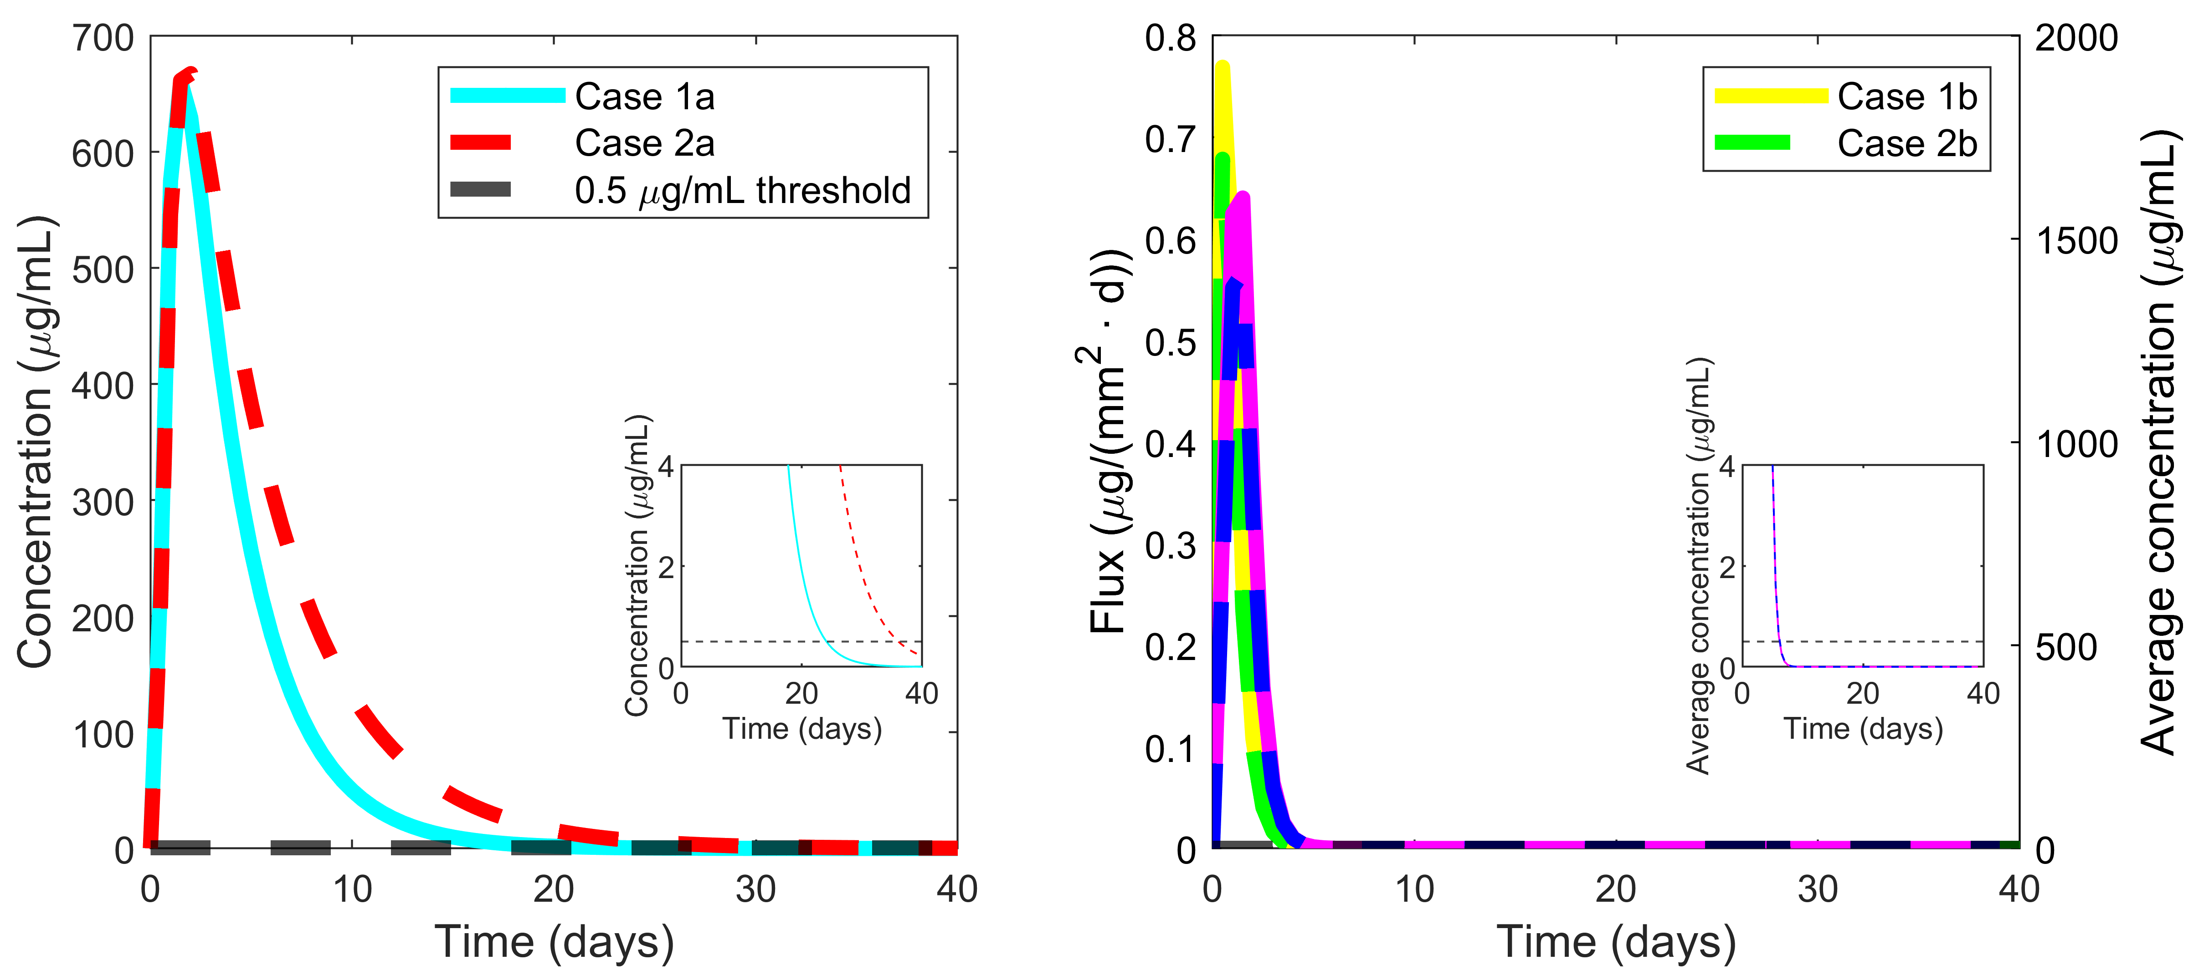
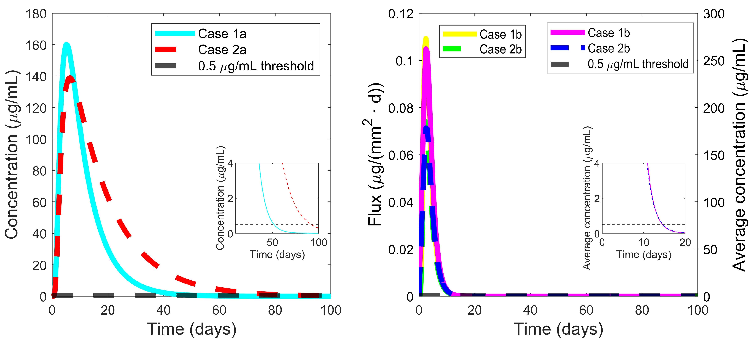
Figure S3
a)
b)
c)
d)

Slide 7
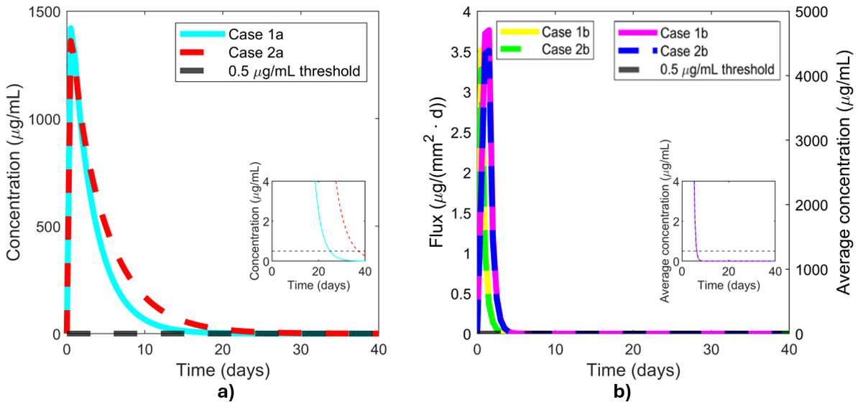
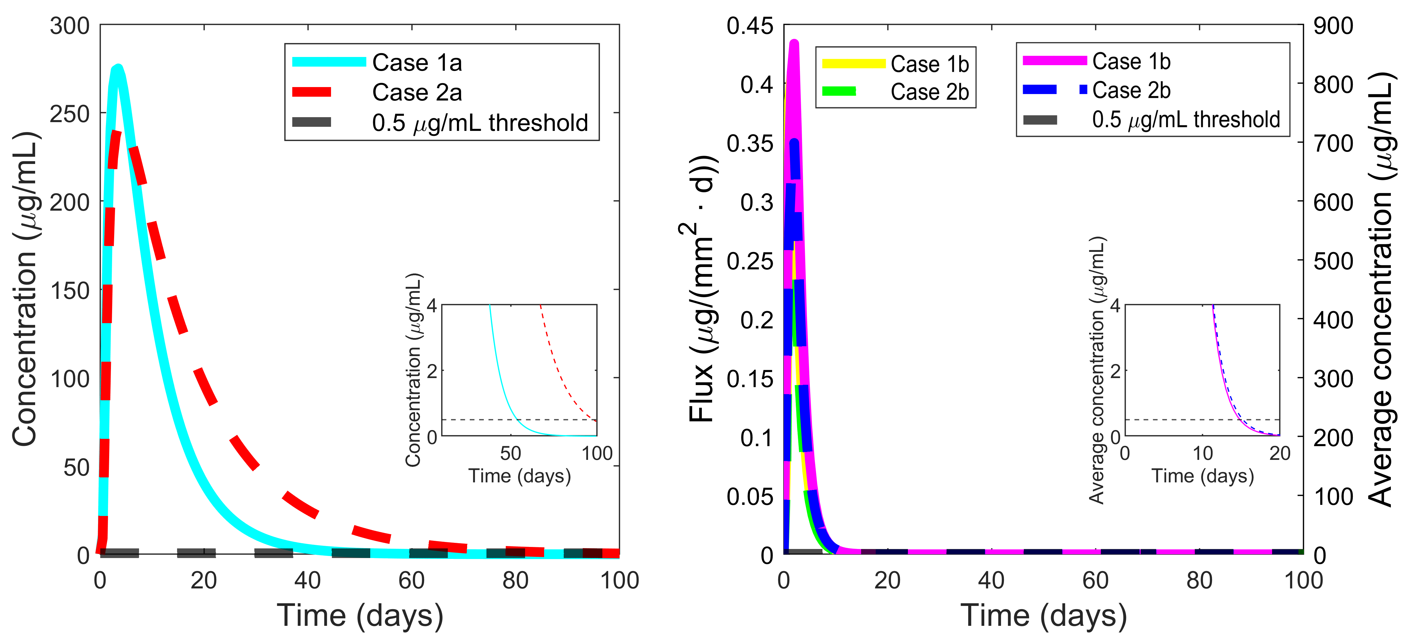
Figure S4
a)
b)
c)
d)

Slide 8
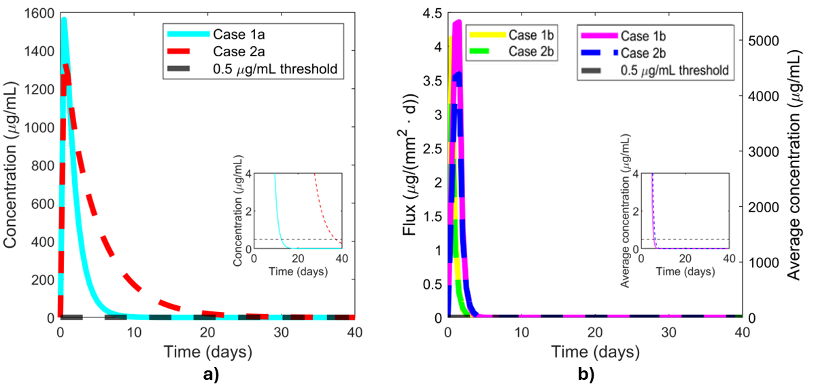
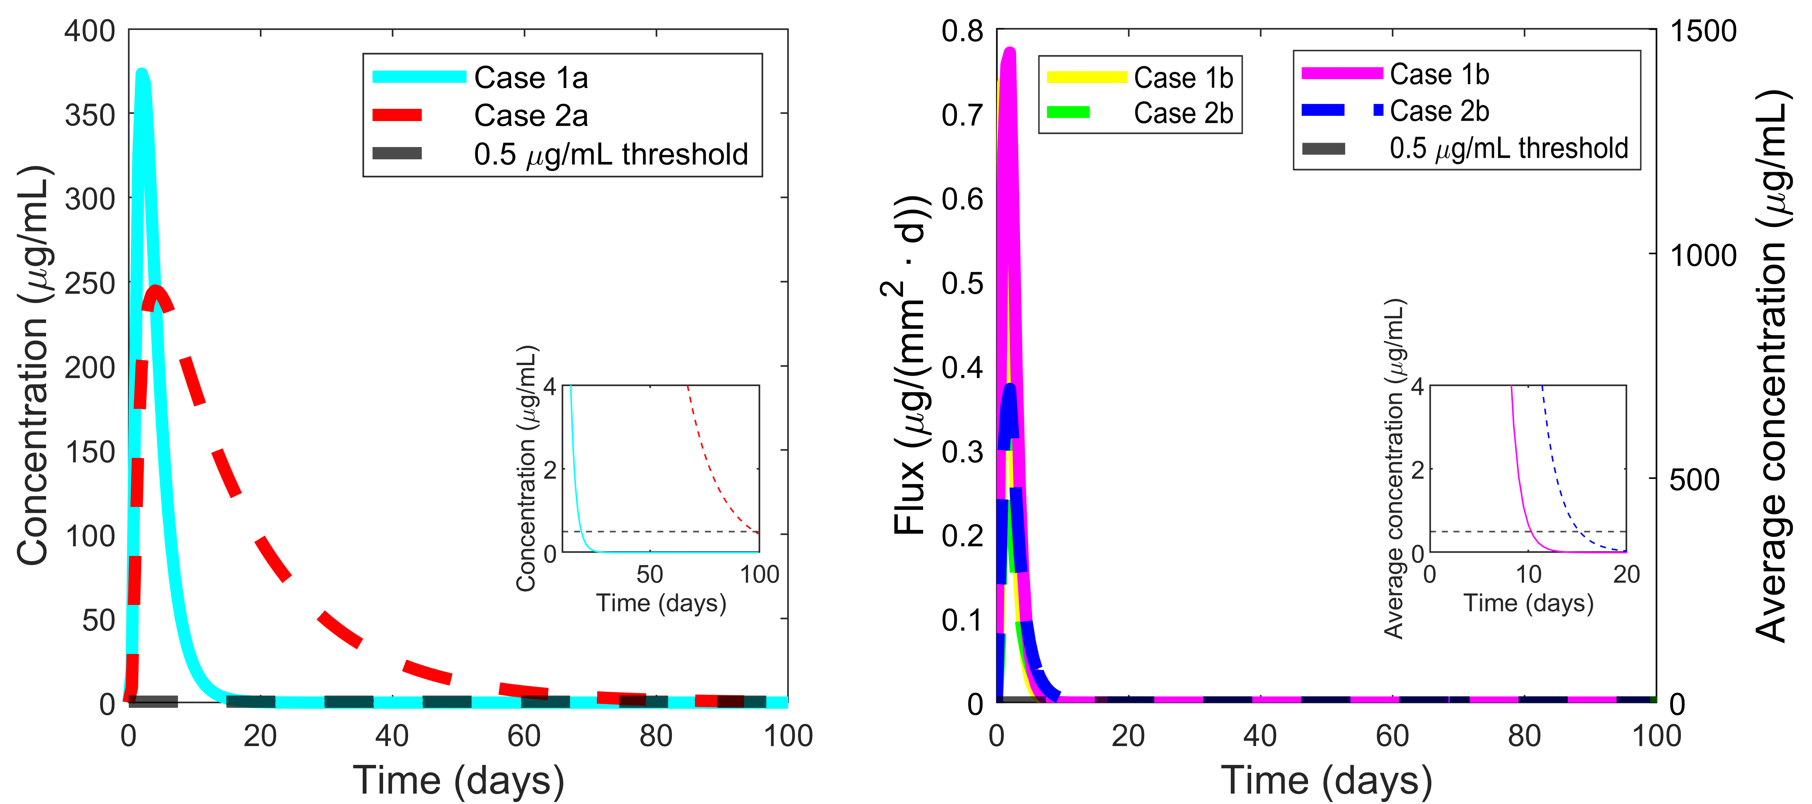
Figure S5
a)
b)
c)
d)

Slide 9
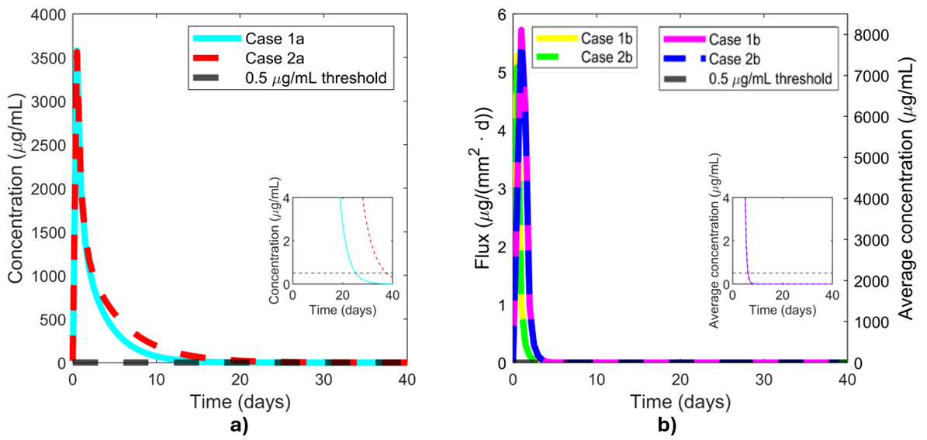
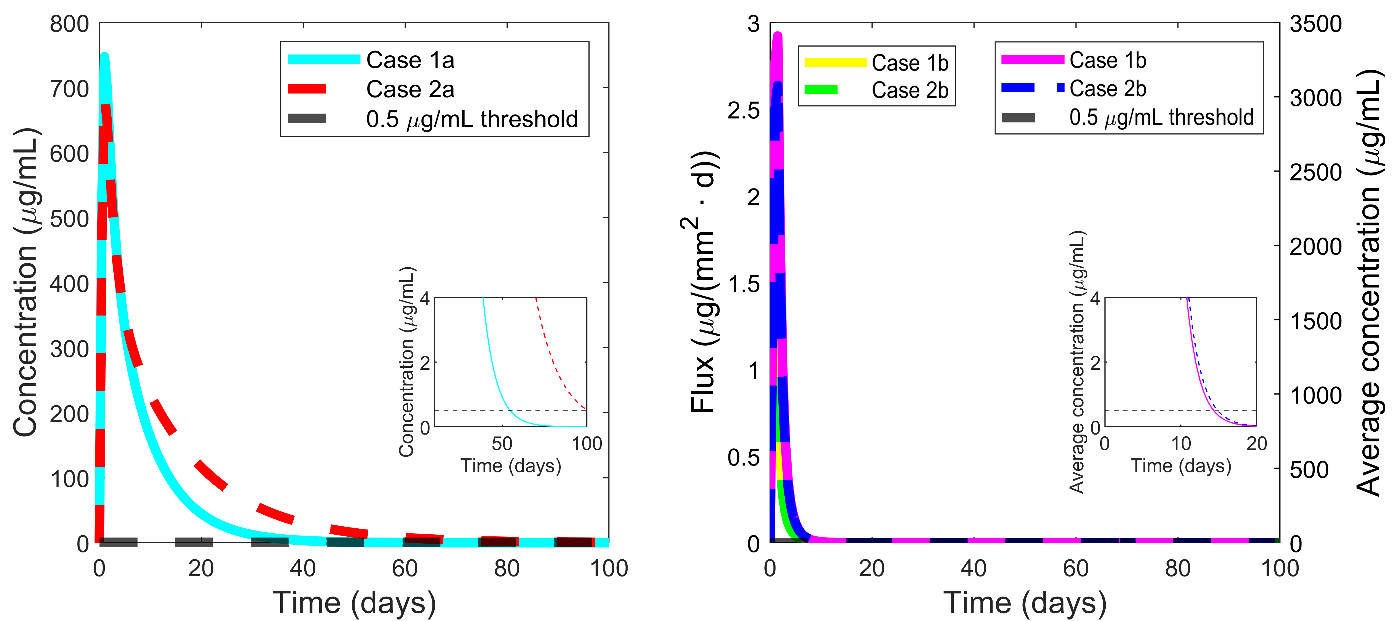
Figure S6
a)
b)
c)
d)

Slide 10
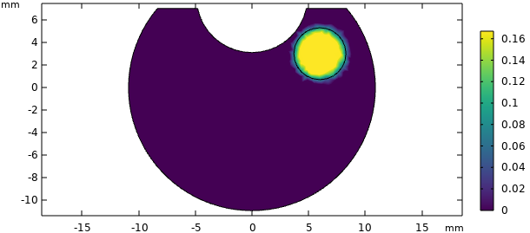
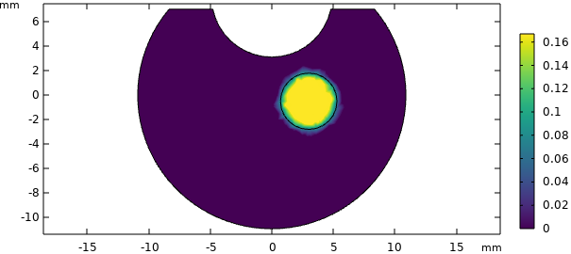
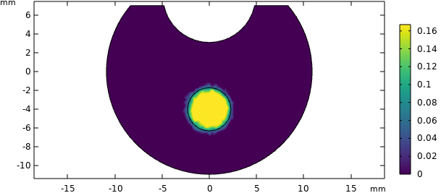
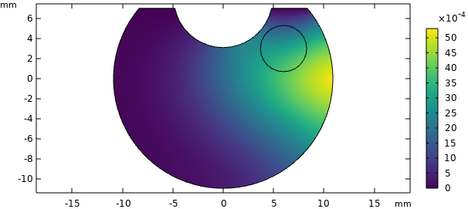
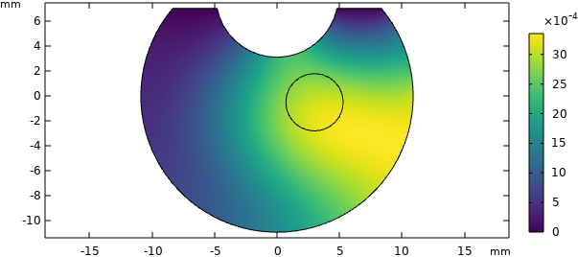
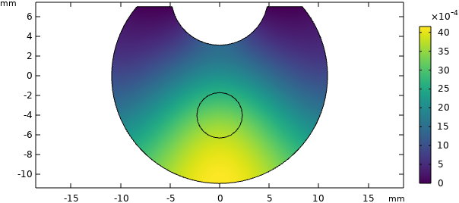
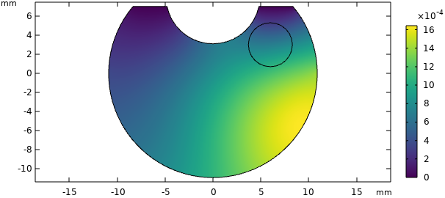
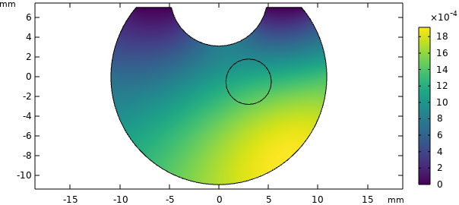
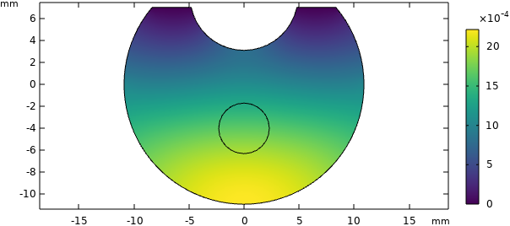
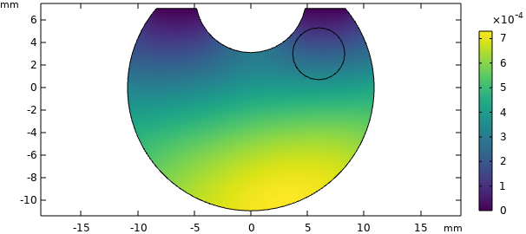
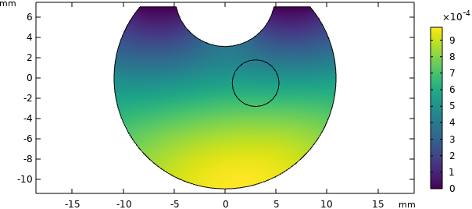
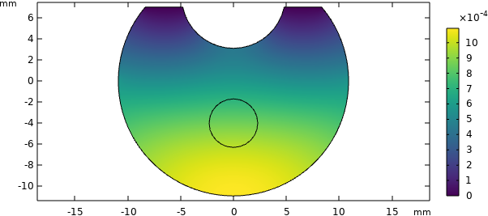
Case 1a
Figure S7
Anterior vitreous
Middle vitreous
Posterior vitreous
t = 0 days
t = 2 days
t = 5 days
t = 10 days

Slide 11
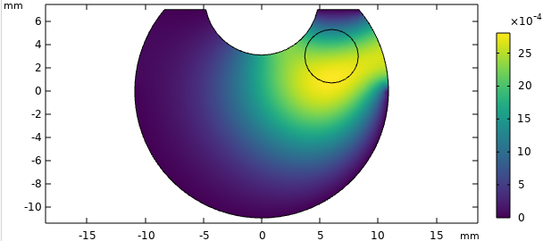
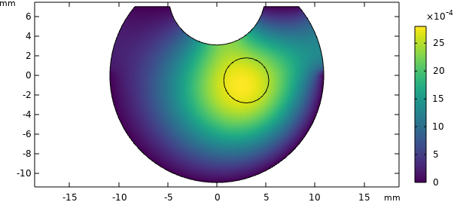
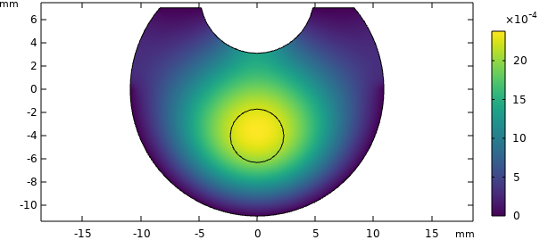
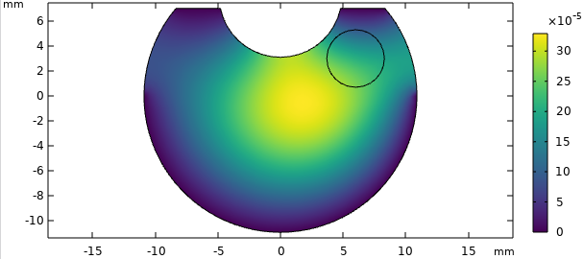
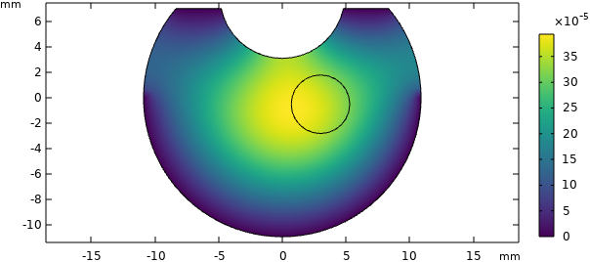
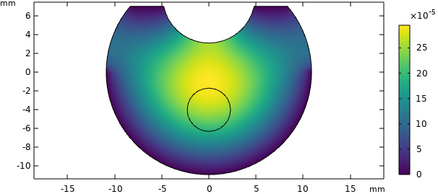
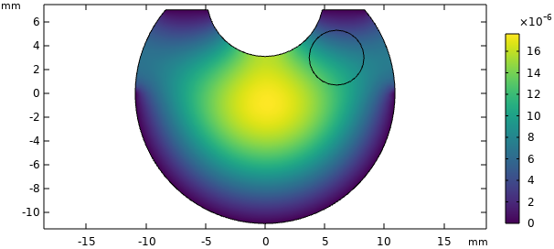

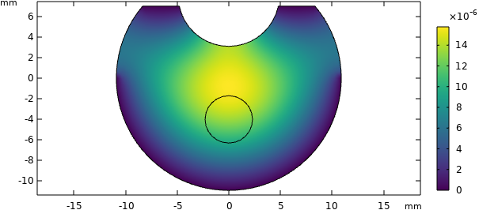
Case 1b
Figure S8
Anterior vitreous
Middle vitreous
Posterior vitreous
t = 0 days
t = 2 days
t = 5 days
t = 10 days

Slide 12
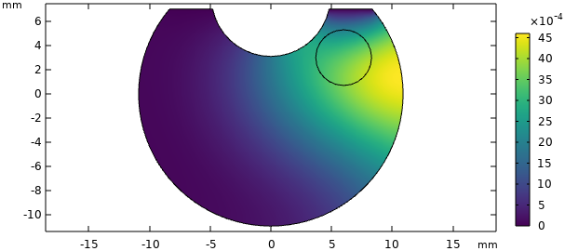
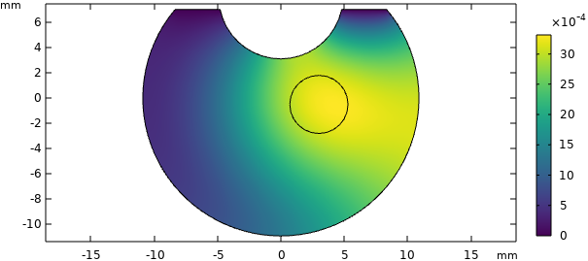
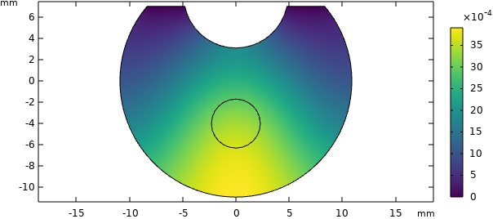
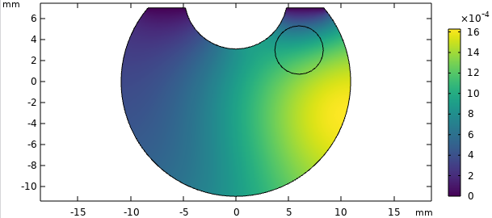
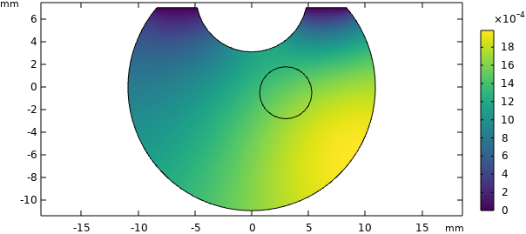
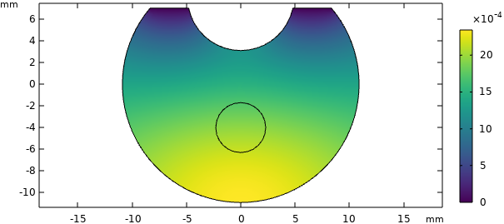
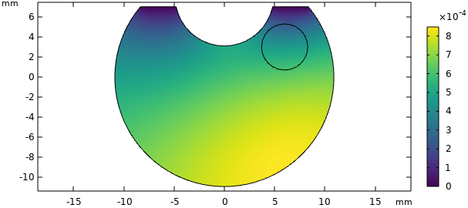
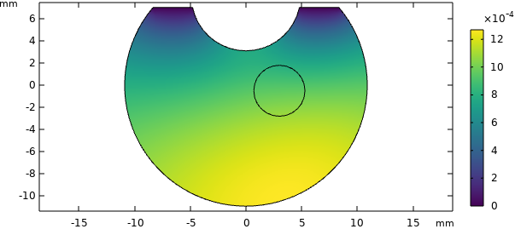
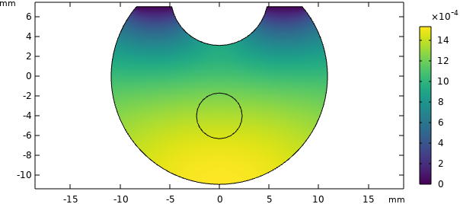
Case 2a
Figure S9
Anterior vitreous
Middle vitreous
Posterior vitreous
t = 0 days
t = 2 days
t = 5 days
t = 10 days

Slide 13









Case 2b
Figure S10
Anterior vitreous
Middle vitreous
Posterior vitreous
t = 0 days
t = 2 days
t = 5 days
t = 10 days

Slide 14

Figure S11
a)
b)

Slide 15


Figure S7
a)
b)
Figure S12
c)
d)

Slide 16


Figure S13
a)
b)
c)
d)

Slide 17


Figure S14
a)
b)
c)
d)

